Slide 1

System Management Tips and Tricks
Mitch Milam
mitch@xrmcoaches.com
@mitchmilam
blogs.infinite-x.net
crmaccelerators.net
xrmcoaches.com

Slide 2
Overview
Reviewing System Maintenance Jobs
Troubleshooting workflow and plugin issues
Managing historical system job information
User management tricks and tips

Slide 3
Reviewing System Maintenance Jobs
Build Personal Views
Monitor system jobs on a regular basis
Take action to correct issues

Slide 4
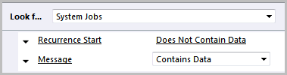
Personal View #1
System Jobs with Messages

Slide 5
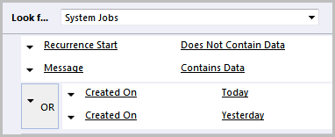
Personal View #2
System Jobs with Messages (Recent)

Slide 6

Personal View #3
System Jobs (Canceled or Failed)

Slide 7
Reviewing System Maintenance Jobs
Cleanup

Slide 8
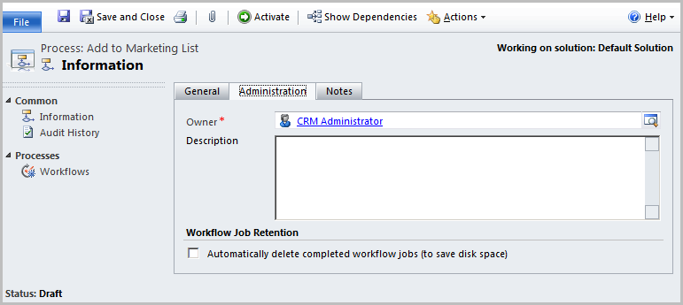
System Job Management: Workflow Execution
Auto-delete successfully completed workflows

Slide 9
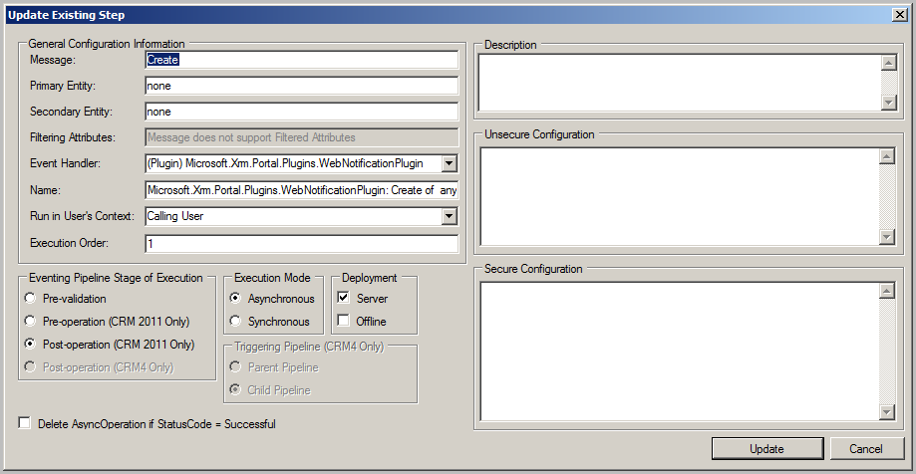
System Job Management: Plugin Execution
Auto-delete successfully completed asynchronous plugin steps

Slide 10
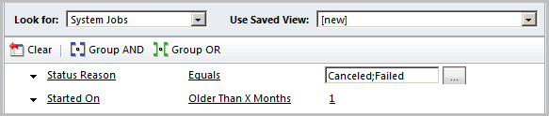
System Job Management: Bulk Delete
Remove canceled or failed jobs

Slide 11
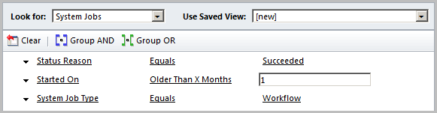
System Job Management: Bulk Delete
Remove successful workflows

Slide 12
User management tricks and tips
System Views
Disabled users consuming licenses
Users with no assigned security roles
Users: Primary E-Mail (Pending Approval)

Slide 13
Personal View – Enabled Users (Detail)
Full Name
Primary E-mail
E-mail 2
Business Unit
Access Mode
License Type
Restricted Access
Incoming E-mail Delivery Method
Outgoing E-mail Delivery Method
Primary E-mail Status

Slide 14
Q and A
Questions?

